Slide 1

North Bank
Finance
Innovating Finance
for Growth and
Prosperity
North Bank is a pioneering fintech company dedicated to
fostering growth, prosperity, and happiness through
innovative financial solutions.

Slide 2

Table of Contents
01
02
03
COMPANY OVERVIEW
MARKET OPPORTUNITY
PRODUCTS & SERVICES
04
05
06
ACHIEVEMENTS & MILESTONES
FINANCIAL PERFORMANCE
CONTACT INFORMATION

Slide 3




North Bank
Finance
ABOUT
SERVICE
CONTACT
Welcome to
North Bank Finance
North Bank is a pioneering fintech company dedicated to fostering growth, prosperity,
and happiness through innovative financial solutions.
DISCOVER MORE
Founded
2018
Headquarters:
San Francisco, California
Empowering Your Financial Future
Building Trust, Inspiring Growth

Slide 4


North Bank
Finance
ABOUT
SERVICE
CONTACT
Leading
the Way
OUR TEAM MEMBERS
Duis aute irure dolor in reprehenderit in voluptate velit esse cillum dolore eu fugiat nulla pariatur.
Excepteur sint occaecat cupidatat non proident, sunt in culpa qui officia deserunt mollit anim id est.
EMPOWERING YOUR FINANCIAL FUTURE

Slide 5
North Bank
Finance
Building Trust
Inspiring Growth
THE MINDS BEHIND
NORTH BANK
John Anderson
Michael Roberts
David Thompson
James Miller
Chief Executive Officer (CEO)
Chief Technology Officer (CTO)
Chief Financial Officer (CFO)
Head of Product Development

Slide 6

North Bank
Finance
Building Trust
Inspiring Growth
VISSION
To revolutionize finance
and empower people to achieve
financial freedom.

Slide 7


North Bank
Finance
ABOUT
SERVICES
CONTACT
Empowering Financial Growth
& Prosperity
Donec ultrices tincidunt arcu non sodales neque sodales. Placerat vestibulum lectus mauris ultrices eros.
In arcu cursus euismod quis viverra. Nulla at volutpat diam ut venenatis tellus in metus. Viverra nam laoreet.
INTRODUCTION
ACHIEVEMENT
BUSSINESS MODEL

Slide 8




North Bank
Finance
Building Trust
Inspiring Growth
CORE VALUES
Growth
Trust
Security
People
Committed to the
financial growth of
our customers.
Building trust through transparency and
reliability.
Ensuring the highest
level of security for
all our services.
Promoting financial
well-being and
happiness..

Slide 9

North Bank
Finance
Building Trust
Inspiring Growth
Exploring Market
Opportunities
$2 trillion
Trends
global fintech market by 2025
Increasing mobile banking usage

Slide 10


North Bank
Finance
Building Trust
Inspiring Growth
Products &
Services
Mauris commodo quis imperdiet massa
tincidunt nunc pulvinar sapien et.
Consequat ac felis donec et.
DIGITAL WALLET
INVESTMENT PLATFORM
P2P
LENDING
Secure, easy-to-use digital wallet.
Tools for managing investments.
Platform for peer-to-peer lending.

Slide 11
North Bank
Finance
PARTNERSHIPS & COLLABORATIONS
Building Trust
Inspiring Growth
Enhanced service offerings, expanded market reach, improved technology infrastructure.

Slide 12
North Bank
Finance
Revenue Streams
Cost Structure
Business Model
At elementum eu facilisis sed odio. Vel risus commodo viverra maecenas.
LEARN
MORE
Transaction fees, subscription services, interest on loans, premium features.
Technology development, customer support, marketing, compliance.

Slide 13


Empowering Your Financial Future
Enhancing User Experience
24/7
CUSTOMER
SUPPORT
Clean, modern design
Optimize the user interface for various devices and screen sizes.
A responsive design ensures that the content is accessible and visually appealing on desktops, tablets,
and smartphones.
North Bank
Finance

Slide 14





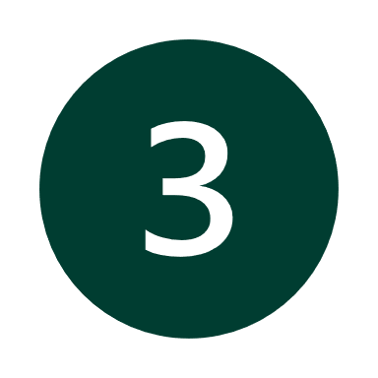
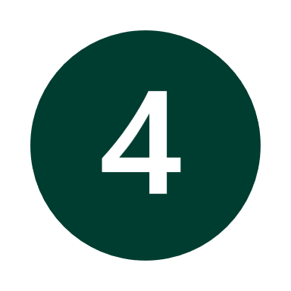

North Bank
Finance
SECURITY MEASURES
End-to-end Encryption
Multi-factor Authentication
AI-Driven Fraud Detection
Secure Infrastructure
Regulatory Compliance

Slide 15
INDUSTRY KNOWLEDGE
North Bank
Finance
The rise of decentralized finance (DeFi) is reshaping the industry.

Slide 16



North Bank
Finance
Building Trust
Inspiring Growth
What Our Customers Say
Duis aute irure dolor in reprehenderit in voluptate velit esse cillum dolore eu fugiat nulla pariatur. Excepteur sint occaecat cupidatat non.
LEARN
MORE
Brian Davis
"I was impressed with the peer-to-peer lending platform at North Bank.”
Adam Johnson
"North Bank's digital wallet has completely transformed how I manage my finances.
It's secure, easy to use, and has
made my life so much simpler."
Daniel Martinez
"North Bank's investment platform has helped me grow my portfolio significantly. The tools and advice they provide are top-notch
and easy to understand."
Charles Williams
“The customer support at North Bank is exceptional. They are always ready to help.”

Slide 17




orth Bank Finance
Index Performance
Excepteur sint occaecat cupidatat non proident, sunt in culpa qui officia deserunt mollit anim id est laborum.
DOLORE
OCCAECAT
PROIDENT
EIUSMOD
Sunt In Culpa Qui Official.
Sunt In Culpa Qui Official.
Sunt In Culpa Qui Official.
Sunt In Culpa Qui Official.
LEARN MORE

Slide 18

orth Bank Finance
ABOUT
SERVICE
CONTACT
Our Social Responsibility
Initiatives, support for local startups, environmental sustainability efforts.
Building Trust
Inspiring Growth

Slide 19

North Bank
Finance
Financial Performance
Duis aute irure dolor in reprehenderit in voluptate velit esse cillum dolore eu fugiat nulla pariatur.
GROWTH & REVENUE
$50 Million
1 Million
15%
$100 Million
Achieved in revenue for
the fiscal year 2023
Reached over 1 million
active users in 2023
Achieved cost savings through optimization
Secured in Series C
funding in 2023

Slide 20
Key Metrics of Our Financial Performance
orth Bank Finance
YEAR
REVENUE
($M)
REVENUE
($M)
REVENUE TARGET
($M)
TARGET
ACHIEVEMENT
2020 | 0.5 | 12 | 10
2021 | 0.8 | 19 | 20
2022 | 1.2 | 35 | 30
2023 | 1.5 | 43 | 40
ACHIEVED
NOT ACHIEVED
ACHIEVED
ACHIEVED

Slide 21
North Bank
Finance
10 $M
20 $M
30 $M
40 $M
Revenue
Growth
Arcu cursus euismod quis viverra nibh. Donec
ac odio tempor orci dapibus. Fames ac turpis
egestas maecenas pharetra convallis
posuere eu tincidunt tortor morbi.
LEARN MORE
2021
2021
2022
2023

Slide 22
orth Bank Finance
ABOUT
SERVICE
CONTACT
ACHIEVEMENTS & MILESTONES
2019
Launched first product, Bank Digital Wallet
2020
Reached 1 million active users.
2022
Expanded services to 10 new countries.
2023
Secured Series C funding of $100 M.

Slide 23
North Bank
Finance
FUTURE
ROADMAP
2025
Short-Term Goals
Launch new investment platform, expand to Asia.
2050
Long-Term Goals
Become the leading fintech provider globally, introduce AI-driven financial advisors.

Slide 24
North Bank
Finance
60%
of our users are under 35 years old. Our platform processes over 100,000 transactions per day.

Slide 25


North Bank
Finance
ABOUT
SERVICE
CONTACT
Contact
Information
Contact us for more information:
ADDRESS
CALL US ON
OUR POLICIES
1234 Market Street, San Francisco, CA 94103
+1 (123) 456-7890
+1 (123) 456-7890
Privacy Policy
Terms of Use

Slide 26

Thank You!
For your time and attention.
Visit our website or contact us for more information:
www.northbank.com

Slide 27


ABOUT NORTH BANK
SERVICES
CONTACT
Ut enim ad minim veniam, quis nostrud exercitation ullamco laboris nisi ut aliquip ex ea commodo consequat.
Duis aute irure dolor in reprehenderit in voluptate velit esse cillum dolore eu fugiat nulla pariatur.
North Bank
Finance

Slide 28

ABOUT NORTH BANK
SERVICES
CONTACT
Ut enim ad minim veniam, quis nostrud exercitation ullamco laboris nisi ut aliquip ex ea commodo consequat.
Duis aute irure dolor in reprehenderit in voluptate velit esse cillum dolore eu fugiat nulla pariatur.
North Bank
Finance

